Slide 1
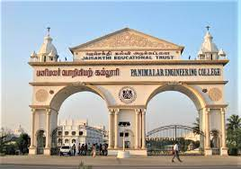

VARICOSE VEINS DISEASE DETECTION AND AUTOMATED TREATMENT USING BAN (BODY AREA NETWORK)
Guide:
DR. G. SENTHIL KUMAR
Batch No: 25
Abishek R 211420104008
Mukesh S 211420104172
Naveen Kumar R 211420104180

Slide 2
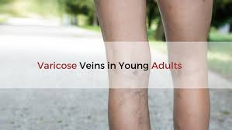
Abstract
The main aim of this paper is to detect and prevent of varicose veins in earlier stage.
Varicose veins are swollen, twisted veins that lie just under the skin and usually occur in the legs. Varicose veins are a common condition caused by weak or damaged vein walls and valves.
DHT11s are used where the former is for the lower body and the latter is for the upper body to keep track of the temperature. Patients will be able to receive rapid temporary therapy and will not have to hurry to hospitals if the rehabilitation system is implemented.

Slide 3
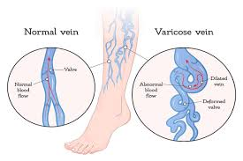
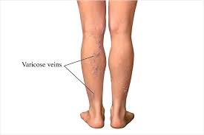
Introduction
Varicose veins can be considered as enlarged veins that have gotten enormous, swollen and turned. Normally they will happen quickly under our skin on legs.
By and large they will bring about certain manifestations yet in barely any cases may encounter a torment around there. Draining can even happen in basic cases not withstanding thrombophlebitis.
At the point when they happen close to the scrotum, they are named varicocele while those that happen around the anus is named as haemorrhoids. Specifically, there is no reason for it.
Varicose veins are most commonly or likely to occur in people who used to stand a lot in their job such as teachers, nurses, policemen etc. It can happen in view of the absence of activity and furthermore because of stoutness.
It can likewise be passed down with ages. They can likewise happen all the more regularly during pregnancy period. In some cases, it will occur because of basic vein inadequacy and it includes either a powerless or a harmed valve or valves. It can happen because of the activity of gravitational power on the blood streaming upwards.
Blood in general, will aggregate at a specific valve because of this activity and can lead to the invert stream of blood.

Slide 4
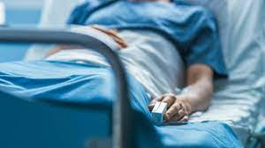

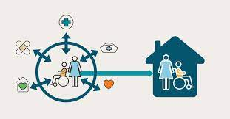
Scope Of The Project
The project's technology advancements include varicose veins patient monitoring and automated treatment, with the goal of providing a temporary solution for varicose veins patients to improve blood circulation and normalisation.

Slide 5
EXISTING SYSTEM
Getting Ahead of Vein Problems: We're starting to focus more on finding and stopping vein problems early instead of waiting until they're really bad.
Using Wearable Devices to Keep Track: Wearable devices can help us keep an eye on things like temperature and blood flow in our veins to catch problems early.
Problems with Current Devices: The devices we have now don't always work perfectly. They can't always check things all the time, they're not always accurate, and they don't give us personalized advice.
Personalized Help is Important: It's essential to get advice and treatments that are made just for you and your specific risks and preferences.
Bright Future for Better Devices: Even though we have issues now, we're hopeful because technology is getting better. We think that soon, wearable devices will be even more helpful in finding and preventing vein problems, making people healthier.

Slide 6
DISADVANTAGES
There is no automated mechanism for administering therapy, and the expense of treatment is significant.
The treatment to Varicose veins sudden pain from level 2 are physiotherapy which the patient will not be able to get done when required.
Moreover, they will have to rush to the hospital to subsidise the pain that is caused by the sudden strain on the veins.
This is an added responsibility which cannot be done all the time.

Slide 7
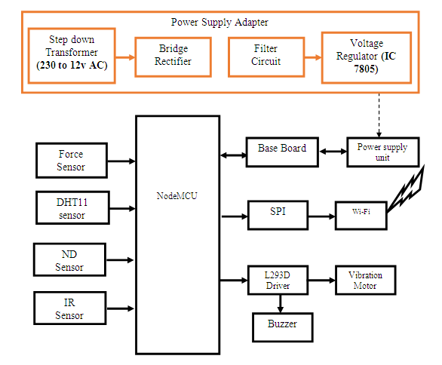
PROPOSED SYSTEM
PROPOSED ARCHITECTURE
Varicose veins patient monitoring and automated therapy are among the project's technological developments, with the purpose of offering a temporary solution for varicose veins patients to improve blood circulation and normalisation.
The project's technology innovations include varicose veins patient monitoring and automated therapy, with the goal of providing a temporary solution for varicose veins patients to enhance blood circulation and normalise their veins.
This will result in immediate temporary treatment to the patient which is reduce the pain easing the patient.
They would not have the need to rush to the near hospital or their physiotherapist.
This will also make them independent as they don’t have to rely on any medical assistance for further treatment.
This also decreases the expensive billsto be paid to theirrespective therapist.
Wearing clothing that is too tight can limit blood flow. Wearing loose-fitting garments that do not limit blood flow to the lower body may promote circulation

Slide 8
METHODOLOGY
While there are several non-invasive procedures for measuring arterial blood pressure, venous blood pressure (VBP), which is important for monitoring intravascular volume status, is still invasive and is mainly performed on seriously ill patients.
While there are various non- invasive ways to measure arterial blood pressure, venous blood pressure (VBP), which is critical for monitoring intravascular volume status, isstill invasive and only done on seriously ill patients.
In this project, we used an Arduino UNO microcontroller, which acts as the brain of the system and holds all of the software.
In this system, the DHT11 is used to determine the body temperature.
It has two points of attachment to the patient's body.
As a result, one is linked to the chest, while the other is linked to the leg position.
The Wi-Fi acts as a communication tool.
The Wi-Fi delivers information to the receiver if one of the DHT11 detects a change in leg position.
The vibration motor starts up when ND, IR, FORCE sensor give a alert
This study's primary purpose is to provide temporary relief from varicose veins.

Slide 9
HARDWARE REQUIREMENT
Power supply unit
Power Supply Adapter
NodeMCU
Base Board
Force Sensor
IR Sensor
DHT11 sensor
L293D Driver
Vibration Motor
ND Sensor
Wi-Fi
SPI
Buzzer

Slide 10
SOFTWARE REQUIREMENTS
Arduino IDE
Thingspeak

Slide 11
References
[1]. H.Lau, J.Chang, N.Daut, A.Tahir, E.Samino, and M.H. Hijazi,”Exploring edge-based segmentation towards automated skin lesion diagnosi,” adv.sci.lett.,vol.24,no.2,pp.1095-1099, 2018.
E.S.Asl, M.Ghazal, A.Mahmoud, A.Aslantas, A. Shalaby, M. Casanova, G. Barnes, G. Gimel’Farb, R. Keynton, and A. El Baz, ‘‘Alzheimer’s disease diagnostics by a 3D deeply super vised adaptable convolutional network,’’ Frontiers Biosci., vol. 23, no.2,pp.584–596,2018.
J.Kawahara, C.J.Brown, S.P.Miller, B.G.Booth, V.Chau, R. E.Grunau, J. G. Zwicker, and G. Hamarneh, ‘‘BrainNetCNN: Convolutional neural networks for brain networks; Towards predicting neurodevelopment,’’ NeuroImage, vol. 146, pp. 1038–1049, Feb. 2017.
O.Shumlov, M. Smagin, V. Nimaev, A.Saovskii “radio frequnecy ablation of varicose veins in obese patients”IEEE volume 978, 2018. varicose vein is detected under these 2 functions.The compression provides the best non-invassive treatment.
Y. Yuan, M. Chao, and Y.-C. Lo, ‘‘Automatic skin lesion segmentation using deep fully convolutional networks with Jaccard distancw,’’ IEEE Trans. Med. Imag., vol. 36, no. 9, pp. 1876–1886, Sep. 2017.
A.S Borde,G.V Savrasov,”Mathemitical modelling of varicose veins ultrasound heating”,IEEE2019.
Wanghyun kim,Tae-hee woo,”A new method for remedy of varicose veins using horn antenna”, IEEE 2019.

